Slide 1
Study Skills
Ms. Wong
24-25

Slide 2
Contact Information
Email:
Bianca_wong@chino.k12.ca.us
Phone:
(909) 923-3455 ext. 6410
Website:
https://www.chino.k12.ca.us/Page/54789

Slide 3
Course Description
Study Skills is an elective to help students get off to a great start.
Students will have the opportunity to:
Organize their assignments, fill in their agenda daily, and ask questions in a small group environment.
Learn skills to study for upcoming tests, and work on class projects.
Finish assignments from previous classes or to makeup absent/late work.
It is very rare that students finish ALL homework during this elective. Please expect your child to have homework when they get home and check their agenda daily.

Slide 4
Grading Policy
Grading is cumulative.
Each assignment is given a point value and at the end of each grading period, assigned points are totaled for a final grade.
Late Work
To achieve a passing grade in this class, all assignments must be submitted by the due date. Late work will be accepted until the 6-week progress report but may be subject to point loss.
Absences
If a student is absent, they have one week to submit the missing work before significant point loss.

Slide 5
Class Routines
Students are expected to write in their agendas daily, covering every subject. (Exception: PE)
Students must complete daily work honestly and type for 10-15 minutes every day.
Students will then, complete/work on any homework assignments.
Finally, students are expected to study or prepare for upcoming quizzes, tests, and presentations.
Important:
Backpack Checks are bi-weekly.
Agenda Checks are daily.
Typing Tests and Grade Checks are every six weeks.

Slide 6
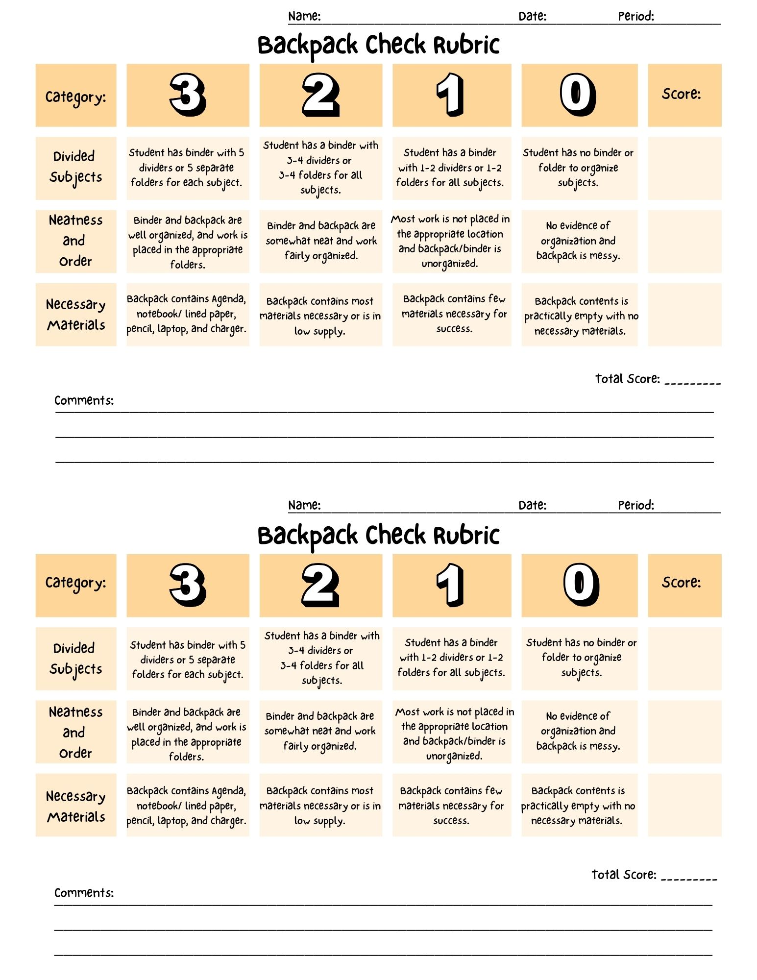
Essential Materials
Students will need to remember to bring the following materials to class:
Backpack or book bag
Agenda
Binder with a system for
dividing each subject
(folders or dividers)
Notebook or lined paper
Pencil
Laptop
Charger

Slide 7
Graduating from Study Skills
Your student will have opportunities to graduate from Study Skills if they maintain the following requirements:
No grades below a C-
A GPA of 2.5 or higher
When students graduate, they make take another elective like art or band!

Slide 8
Questions?

